Slide 1
2. Financial Statement Analysis
Financial statements:
Balance sheet
profit or loss statement
cash flow statement
Statement of change in shareholders’ equity;
Framework for analysis;
Nature and need of financial ratio analysis;
Types of financial ratios:
liquidity ratios
asset management ratios
debt management ratios
profitability ratios
market value ratios;
DuPont system of financial ratio analysis;
Ratios in different industries;
Uses and limitations of financial ratios;
Common size and index analysis.

Slide 2
Financial Statements and Reports
Annual report: A report issued annually by a corporation to its stockholders. It contains basic financial statements, as well as management’s analysis of the past year’s operations and opinions about the firm’s future prospects.
Financial Statement: Contain the basic financial information about revenues, expenditures, expenses, assets, liabilities, cash flow during a specified period
Financial statement reports what has actually happened to assets, earnings and dividends over the past few years whereas verbal statement attempts to explain why things turned out the way they did
Prepared in accordance with Generally Accepted Accounting Principles (GAAP)

Slide 3
Role of financial statement
Useful in reporting
Useful in business decision making
Useful in forecasting
Other uses
Cash flow to know cash position
To access the viability of investing in business
Whether to grant loan to business or not
Accuracy of tax declared and tax paid
To access creditworthiness of business

Slide 4
Financial Statement and Reports
Balance sheet – provide snapshot of a firm’s financial position at one point of time
Income Statement – summarizes a firm’s revenues and expenses over a given period of time
Statement of cash flow – reports the impact of a firm’s activities on cash flow over a given period of time
Statement of change in shareholders equity – reconciliation between the opening balance and closing balance of shareholder’s equity
(Detail about format and items of each statement will b discussed during numerical portion)

Slide 5
Ratio Analysis
Financial ratio:
quantitative relationship between two or more sets of financial data derived from income statement and balance sheet.
it provides strength and weakness on various aspects of the firm’s performance and status
are designed to help evaluate financial statements

Slide 6
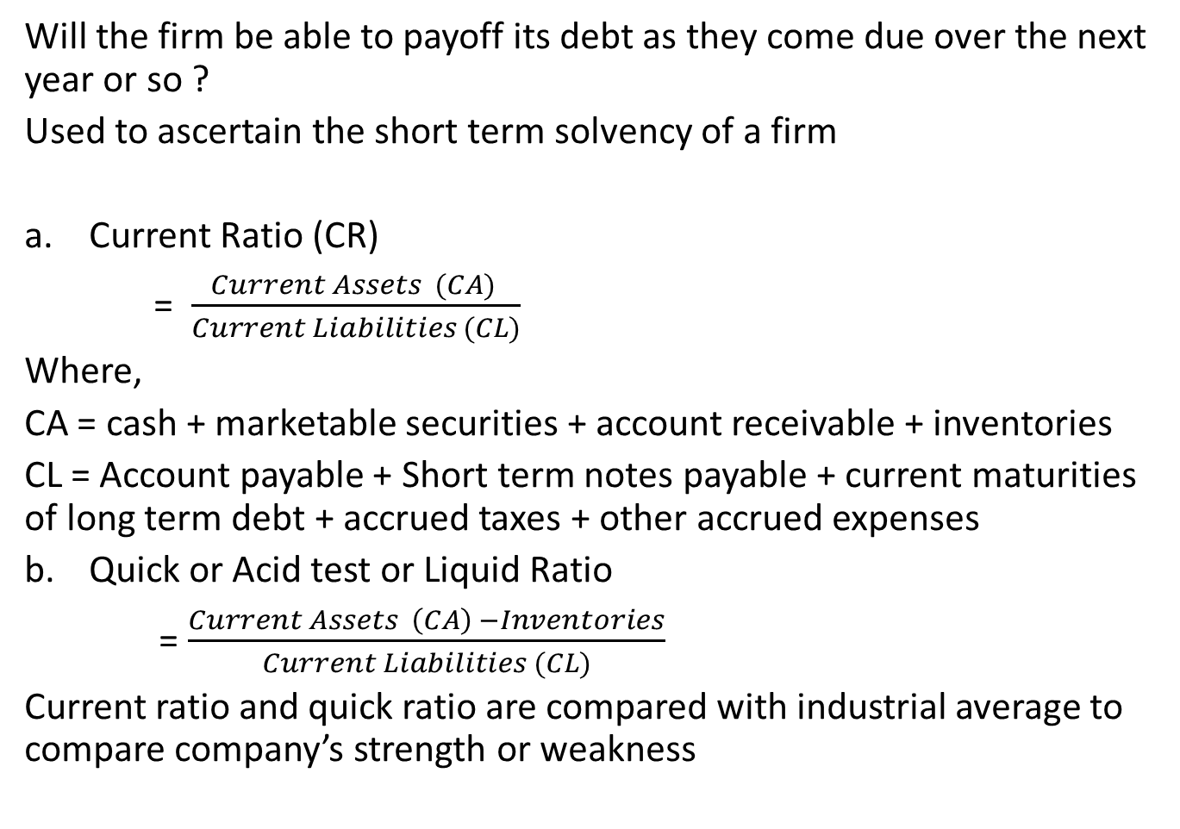
Liquidity Ratio
Will the firm be able to payoff its debt as they come due over the next year or so ?
Used to ascertain the short term solvency of a firm
Current Ratio (CR)
= $\frac{Current Assets (CA) }{Current Liabilities (CL)}$
Where,
CA = cash + marketable securities + account receivable + inventories
CL = Account payable + Short term notes payable + current maturities of long term debt + accrued taxes + other accrued expenses
Quick or Acid test or Liquid Ratio
= $\frac{Current Assets \left(CA\right) −Inventories}{Current Liabilities (CL)}$
Current ratio and quick ratio are compared with industrial average to compare company’s strength or weakness

Slide 7
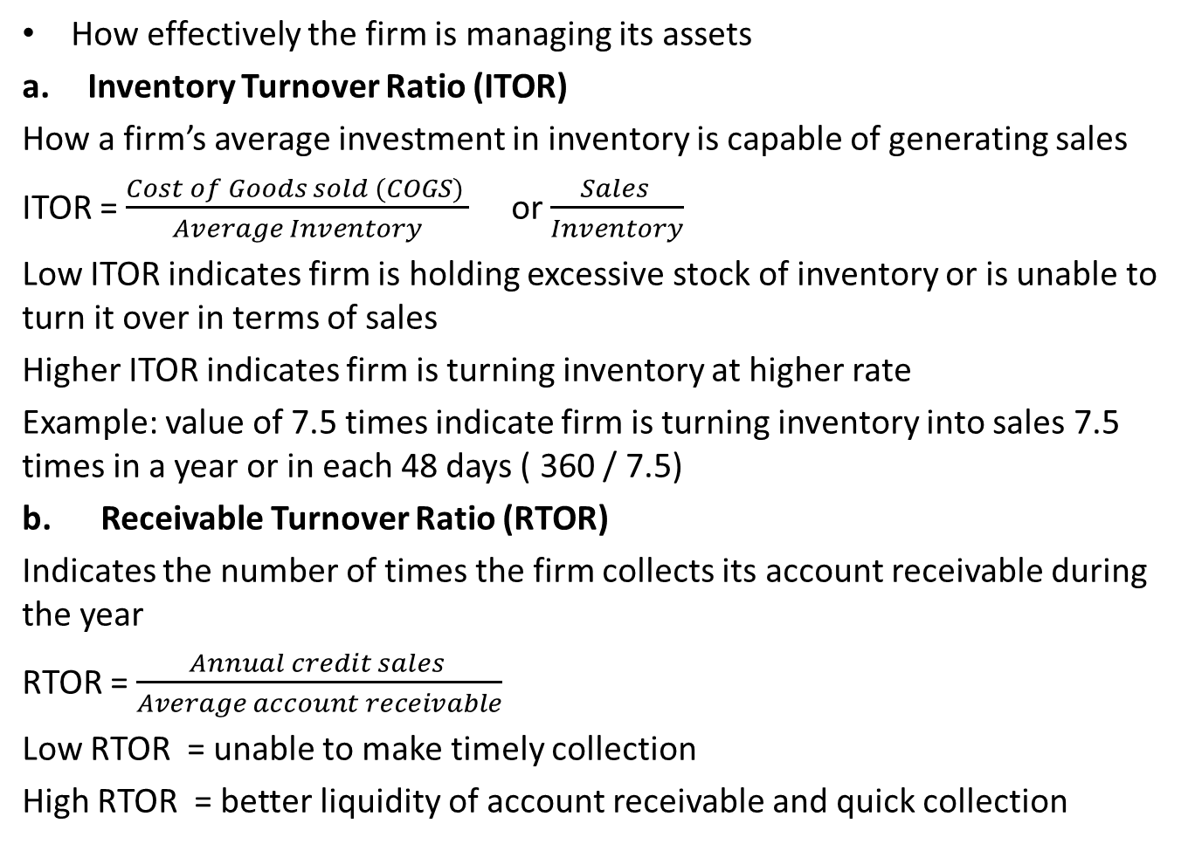
Asset Management Ratio
How effectively the firm is managing its assets
Inventory Turnover Ratio (ITOR)
How a firm’s average investment in inventory is capable of generating sales
ITOR = $\frac{Cost of Goods sold (COGS) }{Average Inventory}$ or $\frac{Sales }{Inventory}$
Low ITOR indicates firm is holding excessive stock of inventory or is unable to turn it over in terms of sales
Higher ITOR indicates firm is turning inventory at higher rate
Example: value of 7.5 times indicate firm is turning inventory into sales 7.5 times in a year or in each 48 days ( 360 / 7.5)
b. Receivable Turnover Ratio (RTOR)
Indicates the number of times the firm collects its account receivable during the year
RTOR = $\frac{Annual credit sales }{Average account receivable}$
Low RTOR = unable to make timely collection
High RTOR = better liquidity of account receivable and quick collection

Slide 8
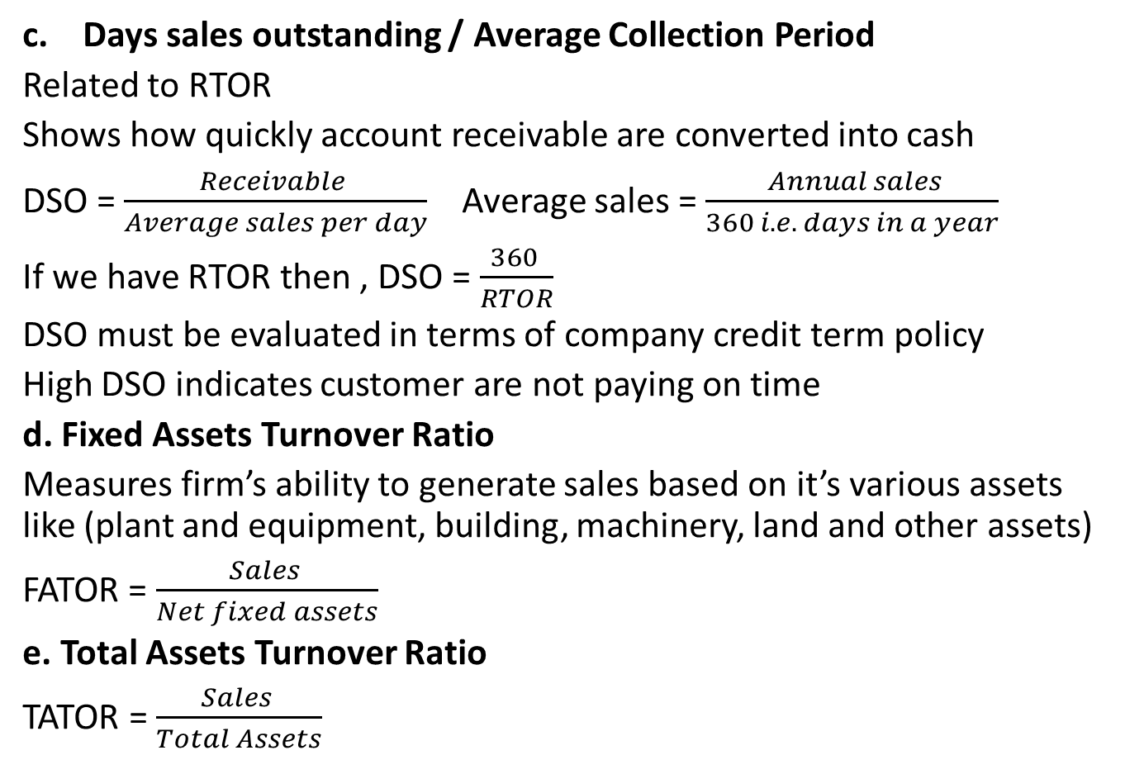
Asset Management Ratio
c. Days sales outstanding / Average Collection Period
Related to RTOR
Shows how quickly account receivable are converted into cash
DSO = $\frac{Receivable }{Average sales per day}$ Average sales = $\frac{ Annual sales}{360 i.e. days in a year}$
If we have RTOR then , DSO = $\frac{360 }{RTOR}$
DSO must be evaluated in terms of company credit term policy
High DSO indicates customer are not paying on time
d. Fixed Assets Turnover Ratio
Measures firm’s ability to generate sales based on it’s various assets like (plant and equipment, building, machinery, land and other assets)
FATOR = $\frac{Sales }{Net fixed assets}$
e. Total Assets Turnover Ratio
TATOR = $\frac{Sales }{Total Assets}$

Slide 9
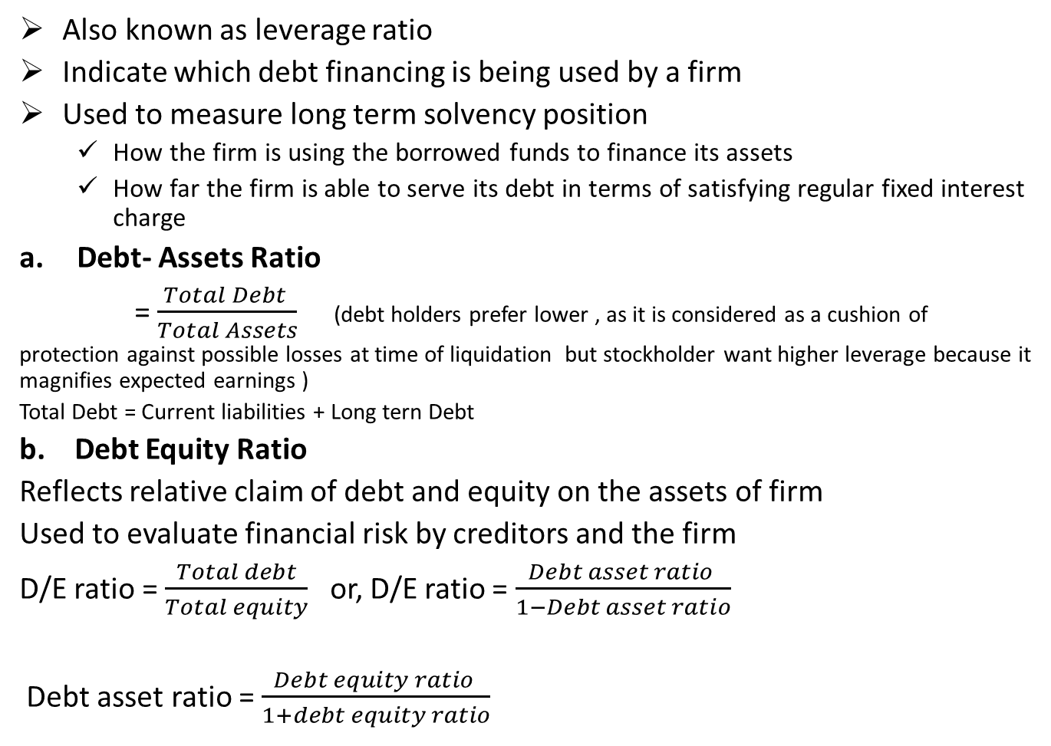
Debt Management Ratio
Also known as leverage ratio
Indicate which debt financing is being used by a firm
Used to measure long term solvency position
How the firm is using the borrowed funds to finance its assets
How far the firm is able to serve its debt in terms of satisfying regular fixed interest charge
Debt- Assets Ratio
= $\frac{Total Debt }{Total Assets}$ (debt holders prefer lower , as it is considered as a cushion of
protection against possible losses at time of liquidation but stockholder want higher leverage because it magnifies expected earnings )
Total Debt = Current liabilities + Long tern Debt
b. Debt Equity Ratio
Reflects relative claim of debt and equity on the assets of firm
Used to evaluate financial risk by creditors and the firm
D/E ratio = $\frac{Total debt}{Total equity}$ or, D/E ratio = $\frac{Debt asset ratio }{1−Debt asset ratio}$
Debt asset ratio = $\frac{Debt equity ratio }{1+debt equity ratio}$

Slide 10
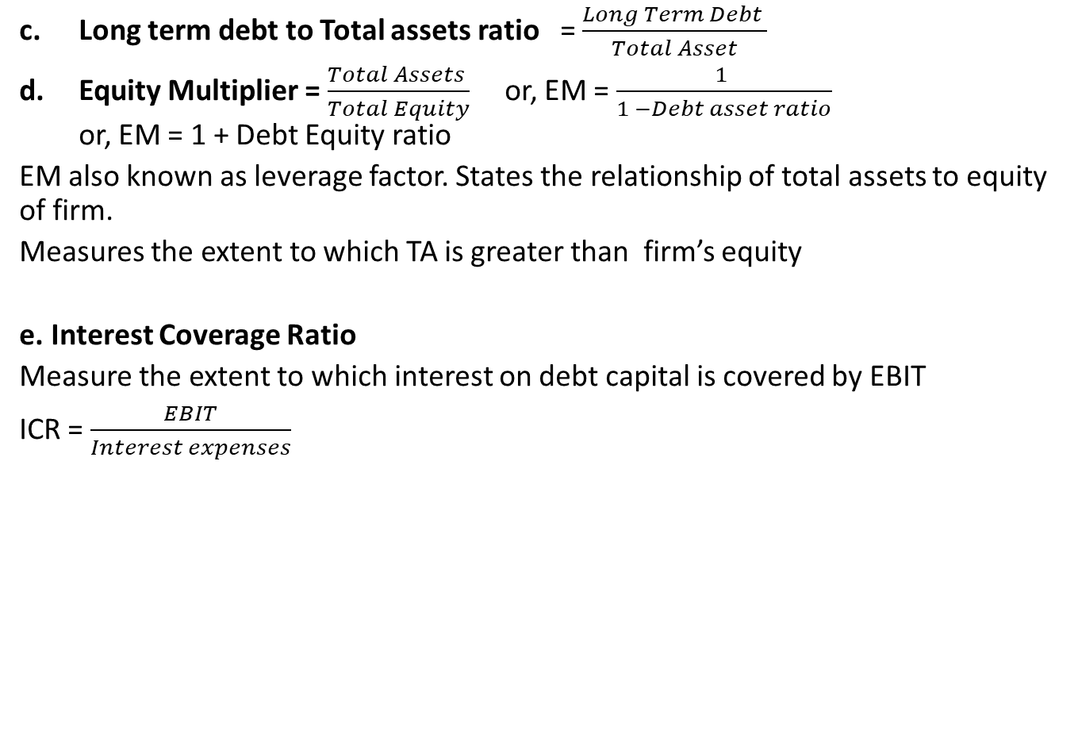
Debt Management Ratio
Long term debt to Total assets ratio = $\frac{Long Term Debt }{Total Asset}$
Equity Multiplier = $\frac{Total Assets }{Total Equity}$ or, EM = $\frac{1 }{1 −Debt asset ratio}$ or, EM = 1 + Debt Equity ratio
EM also known as leverage factor. States the relationship of total assets to equity of firm.
Measures the extent to which TA is greater than firm’s equity
e. Interest Coverage Ratio
Measure the extent to which interest on debt capital is covered by EBIT
ICR = $\frac{EBIT}{Interest expenses}$

Slide 11
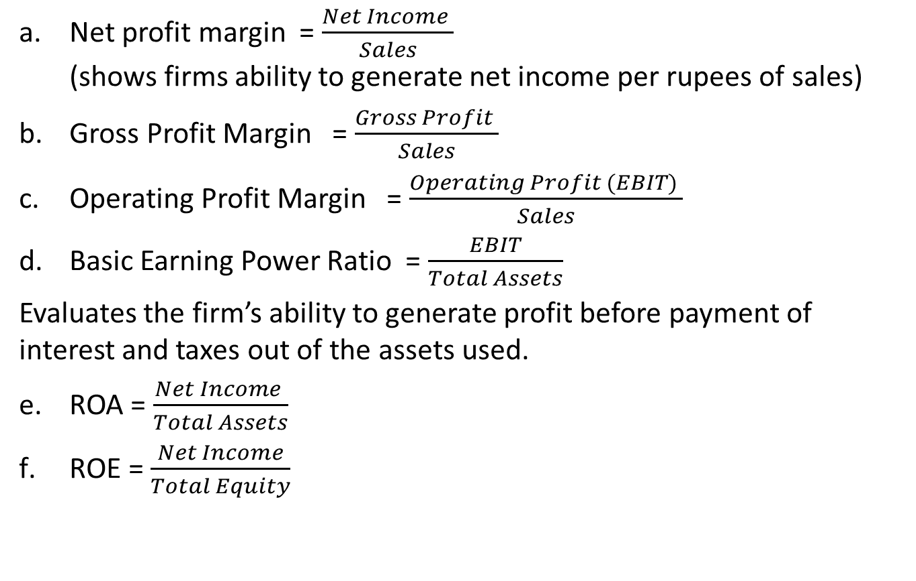
Profitability Ratio
Net profit margin = $\frac{Net Income }{Sales}$ (shows firms ability to generate net income per rupees of sales)
Gross Profit Margin = $\frac{Gross Profit }{Sales}$
Operating Profit Margin = $\frac{Operating Profit (EBIT) }{Sales}$
Basic Earning Power Ratio = $\frac{EBIT}{Total Assets}$
Evaluates the firm’s ability to generate profit before payment of interest and taxes out of the assets used.
ROA = $\frac{Net Income }{Total Assets}$
ROE = $\frac{Net Income}{Total Equity}$

Slide 12
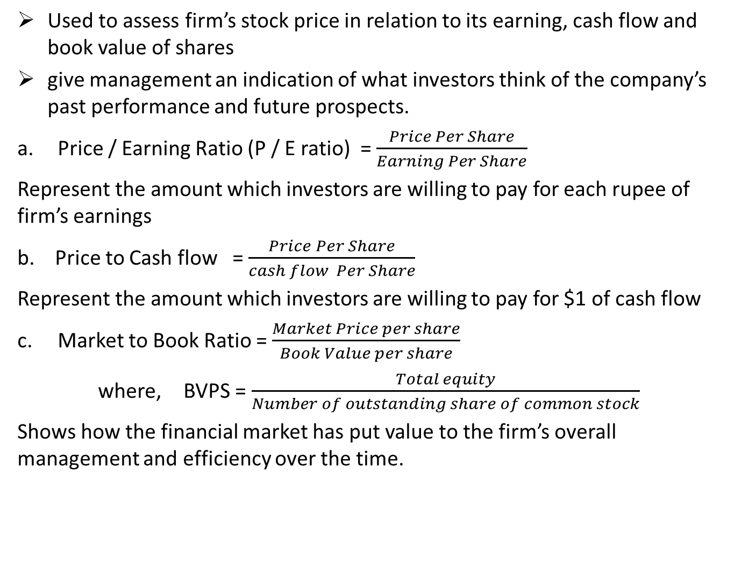
Market Value Ratio
Used to assess firm’s stock price in relation to its earning, cash flow and book value of shares
give management an indication of what investors think of the company’s past performance and future prospects.
Price / Earning Ratio (P / E ratio) = $\frac{Price Per Share}{Earning Per Share}$
Represent the amount which investors are willing to pay for each rupee of firm’s earnings
b. Price to Cash flow = $\frac{Price Per Share}{cash flow Per Share}$
Represent the amount which investors are willing to pay for $1 of cash flow
Market to Book Ratio = $\frac{Market Price per share}{Book Value per share}$
where, BVPS = $\frac{Total equity}{Number of outstanding share of common stock}$
Shows how the financial market has put value to the firm’s overall management and efficiency over the time.

Slide 13
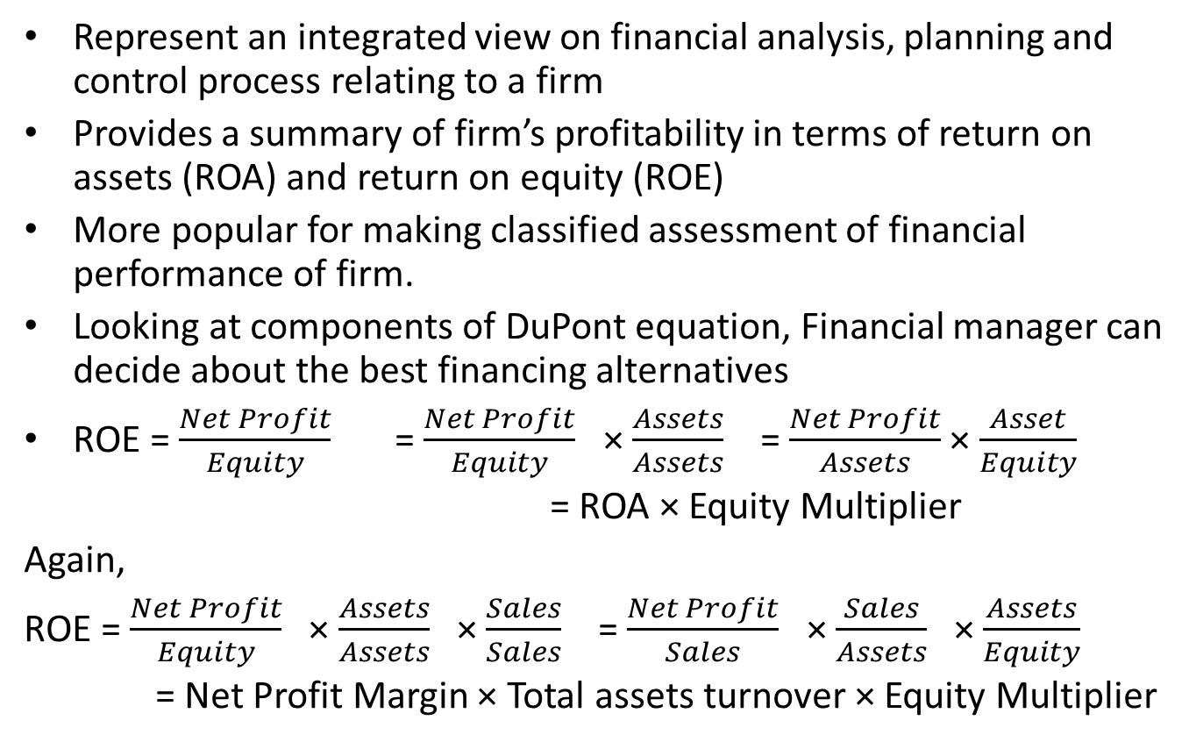
DuPont system of financial ratio analysis
Represent an integrated view on financial analysis, planning and control process relating to a firm
Provides a summary of firm’s profitability in terms of return on assets (ROA) and return on equity (ROE)
More popular for making classified assessment of financial performance of firm.
Looking at components of DuPont equation, Financial manager can decide about the best financing alternatives
ROE = $\frac{Net Profit}{Equity}$ = $\frac{Net Profit}{Equity}$ × $\frac{Assets}{Assets}$ = $\frac{Net Profit}{Assets}$ × $\frac{Asset}{Equity}$
= ROA × Equity Multiplier
Again,
ROE = $\frac{Net Profit}{Equity}$ × $\frac{Assets}{Assets}$ × $\frac{Sales}{Sales}$ = $\frac{Net Profit}{Sales}$ × $\frac{Sales}{Assets}$ × $\frac{Assets}{Equity}$
= Net Profit Margin × Total assets turnover × Equity Multiplier

Slide 14
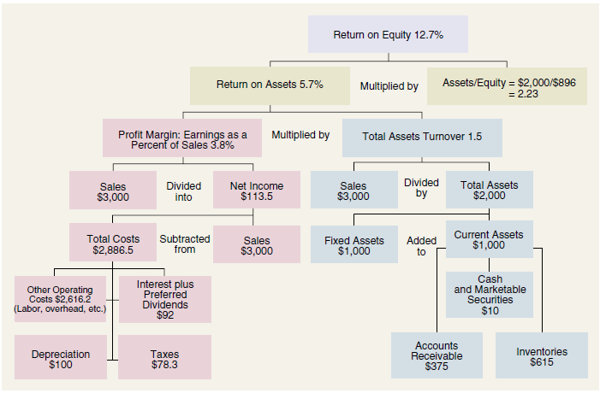

Slide 15
Trend Analysis and Common size statement
Trend Analysis:
Tools that indicate whether the financial condition of a firm is likely to improve or deteriorate
Financial ratio of a firm is plotted against that of industry average to identify whether the movement is confirmed or contradicted to industry average.
Common size statements:
A financial statement that express all items in percentage terms of some common standard items such as sales for income statement and total assets for balance sheet
Balance Sheet Income Statement
Capital and liabilities |  | Assets
A xxx | % of X | D xxx | % of X
B xxx | % of X | E xxx | % of X
C xxx | % of X | F xxx | % of X
Total X | 100% | Total X | 100%
Particulars | Amount | % of sales
Sales | xxx | 100%
Less : A | xxx | % of sales
Add: B | xxx | % of sales
Net Income | xxx | % of sales

Slide 16
Index Analysis
Index against a base year
Balance sheet as well as income statement are adjusted as per base year
All data in indexed B/S and I/S are expressed using 100 base
Example: if sales for year 2019 = 1500000 and sales for year 2020 = 1800000
In index analysis taking 2019 as indexed year
Sales in 2019 = 100
sales in 2020 = 120 (1800000/150000 * 100)
In the same way all items are expressed
If CA in 2019 = 750 and CA in 2020 = 900
In index analysis :
CA in 2019 = 100
CA in 2020 = 120 ( 900/750 * 100)

Slide 17
Uses and limitations of financial ratios
Ratio analysis is used by three main groups
Managers
Credit Analyst
Stock Analyst
Ratio analysis does have some limitations that necessitate care and judgment. Some potential problems are:
Difficult to develop meaning set of industry averages operating different division in different industries
Better to focus industry leader than industry average ; benchmarking tools can be used
Comparison of firms of different ages (affected by inflation, depreciation, inventory)
Seasonal factors can also distort a ratio analysis
Window dressing technique
Different accounting practices can distort comparison (problem has been reduced somehow)
difficult to generalize about whether a particular ratio is “good” or “bad.”

